Slide 1
Principles of the Software Design
Course for Armenian-French University
Areg Melik-Adamyan
Petr Kurapov

Slide 2
Lecture 8
Relational databases

Slide 3
Agenda
Early systems – pre-relational-algebra & problems
The relational algebra
Modern DBMS components and concepts

Slide 4
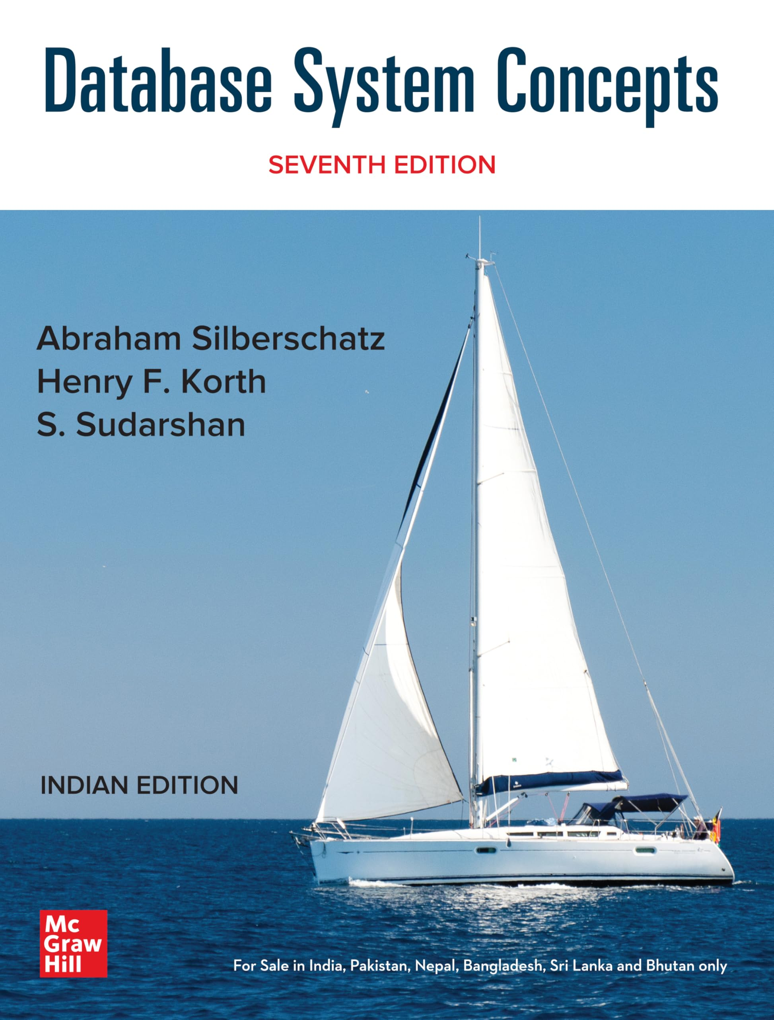
Great source of knowledge
Database System Concepts Seventh Edition
Avi Silberschatz
Henry F. Korth
S. Sudarshan
Great course:
CMU 15-445/645

Slide 5
DBMS – definition
A database is a collection of data relevant to some organization/topic/etc.
Databases are ubiquitous and are the core part of most applications.
A Database Management System (DBMS) is a collection of interrelated data and a set of programs and tools that allow users to access and modify these data.
A DBMS supports data manipulation and administration according to some data model. A data model is a collection of concepts describing the data in a database.

Slide 6
Data models
Hierarchical
Network
Entity-Relationship (E-R)
Object (e.g., json)
Key-Value
Graph
Relational
Tensor
Etc.

Slide 7
Databases: requirements
What if?
Multiple users try to access and modify the data at the same time.
Type of field changes. The number of attributes changes.
Students can now attend multiple courses.
A user adds an invalid record, e.g., a non-unique ID or more attributes than expected.
We need a new application that uses the same database.
The application is running on a different machine.
The physical disk dies.
Data does not fit on a single machine.
students.csv
student_id,name,age,enrolled
1,Alice,20,”Operating Systems”
2,Bob,22,”Operating Systems”
3,Charlie,21,”DBMSes”
An example query implementation:
OPEN student.csv AS students
RESULT ← []
FOR EACH row IN students DO
FIELDS ← SPLIT(row, ",") // Parse CSV row into fields
course ← TRIM(FIELDS[3]) // Extract and clean course_name
IF course = "Database Systems" THEN
APPEND FIELDS[1] TO RESULT // Add student name

Slide 8
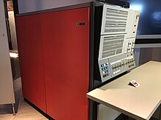

Early days of data management
Hardware outlook:
1950s and early 1960s – magnetic tapes for storage with sequential access
Late 1960s – emerging hard disks allow direct access
Systems outlook:
Ran on mainframes
Network and hierarchical data models
Trends:
Significant data volume and complexity growth
High mainframe operating cost
No data sequentiality on disks
IBM System/360, 1964
IBM z17, 2024
Notes:
z stands for zero downtime
Z – direct descendant of System/360

Slide 9
Early days of data management
A database consists of a collection of records that are connected through links (hierarchical or network data model).
Tight coupling with underlying physical data layout.
Developing an access algorithm requires the knowledge of the physical layout.
New applications may require a complete rewrite.
No standard – increased adoption & maintenance complexity.

Slide 10
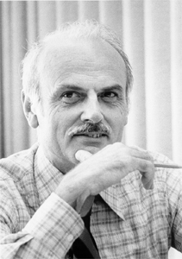
Relational algebra
A relational model of data for large shared data banks (https://dl.acm.org/doi/10.1145/362384.362685)
Vision: a SW architecture that would allow users with no database’s physical layout knowledge to access the data
Data is stored in simple data structures – relations.
Database access is performed at a logical level with a high-level language.
Physical implementation is left to the DBMS.
The System R project -> SQL/DS, DB2, …
Edgar Frank Codd
Turing award, 1981

Slide 11
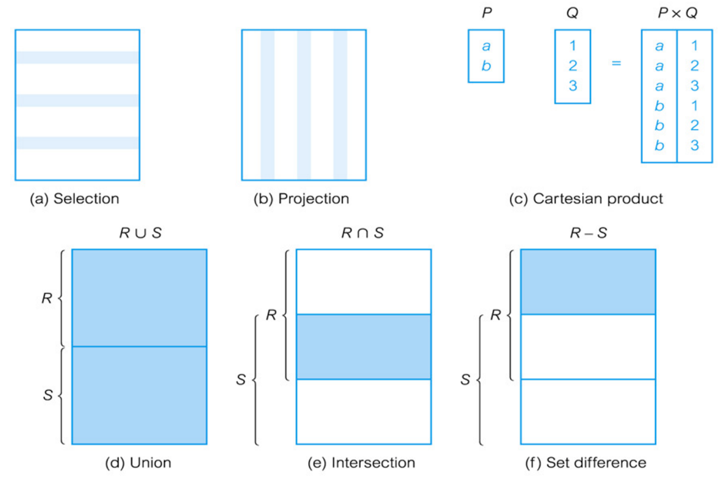
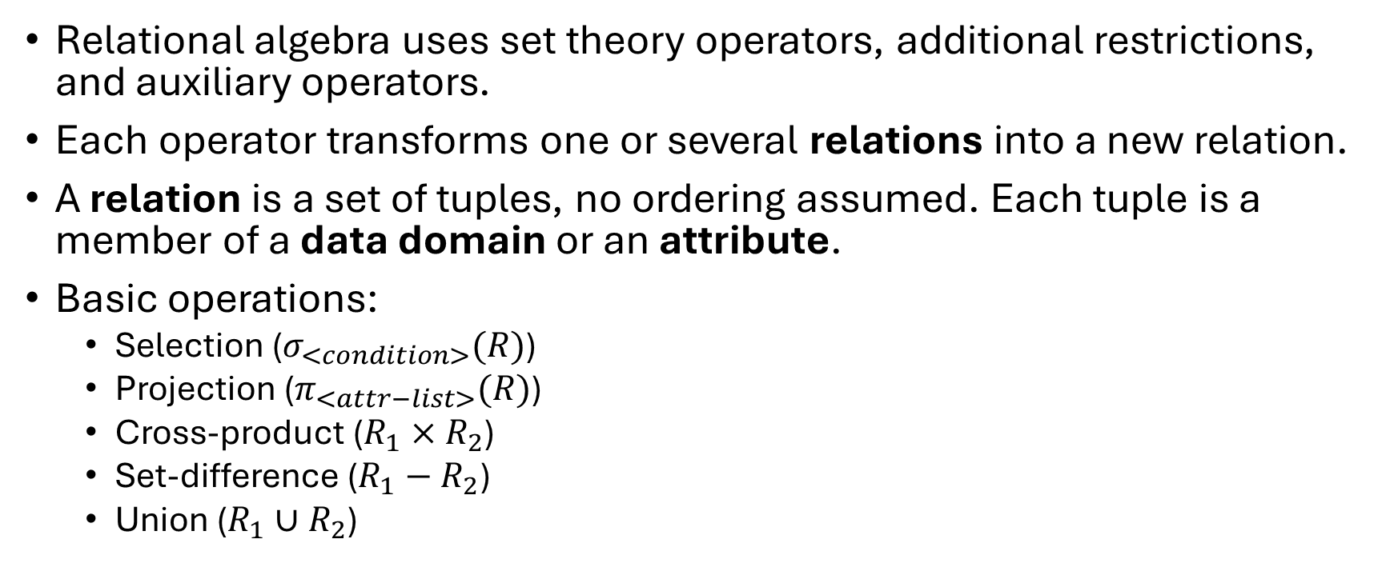
Relational algebra
Relational algebra uses set theory operators, additional restrictions, and auxiliary operators.
Each operator transforms one or several relations into a new relation.
A relation is a set of tuples, no ordering assumed. Each tuple is a member of a data domain or an attribute.
Basic operations:
Selection ($σ_{<condition>}(R)$)
Projection ($π_{<attr−list>}(R)$)
Cross-product ($R_{1}×R_{2}$)
Set-difference ($R_{1}−R_{2}$)
Union ($R_{1}∪R_{2}$)
*CSC 443 – Data Base Management Systems

Slide 12
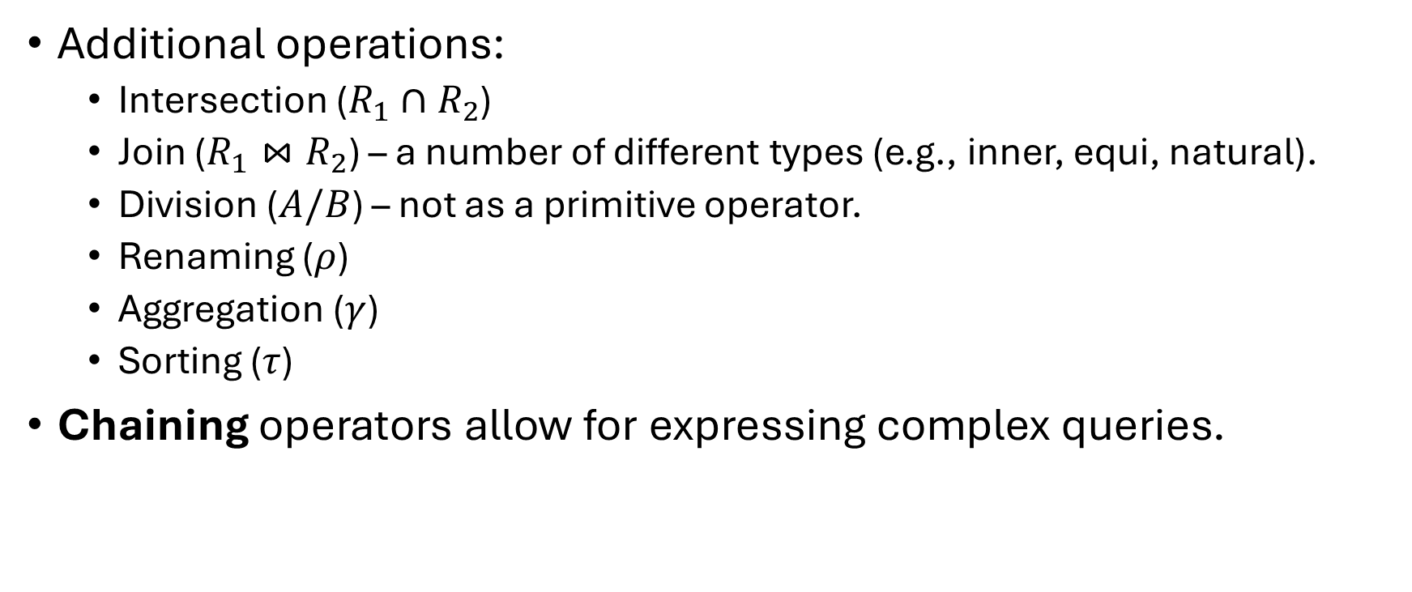
Relational algebra
Additional operations:
Intersection ($R_{1}∩R_{2}$)
Join ($R_{1}⋈R_{2}$) – a number of different types (e.g., inner, equi, natural).
Division ($A/B$) – not as a primitive operator.
Renaming ($ρ$)
Aggregation ($γ$)
Sorting ($τ$)
Chaining operators allow for expressing complex queries.

Slide 13
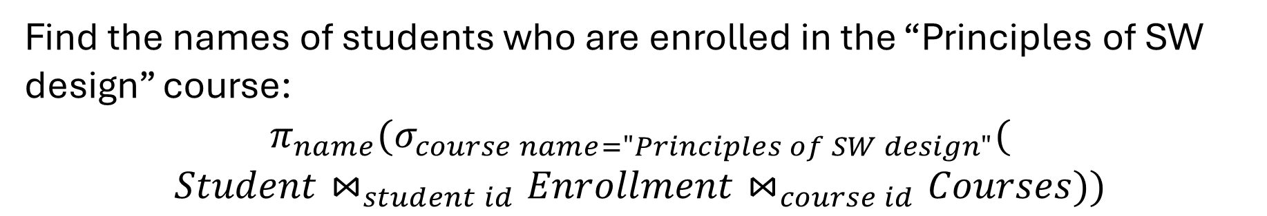
Query example
Student
Enrollment
student_id | name | age
1 | Alice | 20
2 | Bob | 22
3 | Charlie | 21
student_id | course_id
1 | 101
2 | 102
3 | 103
Courses
course_id | course_name | instructor
101 | Principles of SW design | Prof. Melik-Adamyan
102 | Operating Systems | Dr. Kurapov
Find the names of students who are enrolled in the “Principles of SW design” course:
$$π_{name}(σ_{course name="Principles of SW design"}($$
$$Student⋈_{student id}Enrollment⋈_{course id}Courses))$$

Slide 14
Relational databases
Relational DBMSes provide a declarative high-level language to express and use the concepts.
Users describe the what, not the how.
SQL (Structured Query Language) is the de facto standard.
Originally developed at IBM, called SEQUEL (Structured English Query Language) for the System R project. Later picked up by E. Wong and M. Stonebraker to build INGRES.
Standardized in 1986 (with the first major standard in 1992). Still, vendors have dialects, and may not completely follow the standard.
SELECT Student.name
FROM Student
JOIN Enrollment ON Student.student_id = Enrollment.student_id
JOIN Course ON Enrollment.course_id = Course.course_id
WHERE Course.course_name = ‘Principles of SW design';

Slide 15
SQL
SQL consists of multiple sub-languages*:
Data Definition Language (DDL) – for creating and modifying DB objects such as tables or users.
Data Manipulation Language (DML) – reading, deleting, and updating data in the database.
Data Control Language (DCL) – for managing the access to the data, e.g., granting or revoking permissions.
CREATE TABLE Course (
course_id INT PRIMARY KEY,
course_name VARCHAR(100) NOT NULL,
instructor VARCHAR(100) NOT NULL
);
INSERT INTO Course (course_id, course_name, instructor)
VALUES (103, 'Artificial Intelligence', 'Dr. Johnson');
Grant SELECT,INSERT,UPDATE,DELETE on Courses To User1
*Usually there are additional tools for view creation, transaction management (e.g., Microsoft SQL Server’s TCL), and constraints/integrity control.
Notes:
Notice how each language exposes only logical entities

Slide 16
Storage access
Data is organized in blocks, “low” number of pages present in the main memory – not able to store all the data in it
Main memory
Disk
fetch
Block i
Latency Comparison Numbers (~2012)
----------------------------------
L1 cache reference 0.5 ns
Branch mispredict 5 ns
L2 cache reference 7 ns 14x L1 cache
Mutex lock/unlock 25 ns
Main memory reference 100 ns 20x L2 cache, 200x L1 cache
Compress 1K bytes with Zippy 3,000 ns 3 us
Send 1K bytes over 1 Gbps network 10,000 ns 10 us
Read 4K randomly from SSD* 150,000 ns 150 us ~1GB/sec SSD
Read 1 MB sequentially from memory 250,000 ns 250 us
Round trip within same datacenter 500,000 ns 500 us
Read 1 MB sequentially from SSD* 1,000,000 ns 1,000 us 1 ms ~1GB/sec SSD, 4X memory
Disk seek 10,000,000 ns 10,000 us 10 ms 20x datacenter roundtrip
Read 1 MB sequentially from disk 20,000,000 ns 20,000 us 20 ms 80x memory, 20X SSD
Send packet CA->Netherlands->CA 150,000,000 ns 150,000 us 150 ms
Id | Col1 | Col2 | Col3 | …
0
1
2
3
https://gist.github.com/jboner/2841832

Slide 17
Storage access
Data is organized in blocks, “low” number of pages present in the main memory – not able to store all the data in it
i.e. row-store
Sequential table scan – many accesses (# of chunks)
Main memory
Disk
fetch
Block i
Id | Col1 | Col2 | Col3 | …
0
1
2
3
A chunk fits single block

Slide 18
Storage access
i.e. row-store
Sequential table scan – many accesses (# of chunks)
Use index to minimize disk accesses
Main memory
fetch
Disk
Index
Index
Index
access
Data
Block i
Data
Id | Col1 | Col2 | Col3 | …
0
1
2
3
Id | BlockId
0 | X
1 | Y
A chunk fits single block

Slide 19
Storage access
i.e. row-store
Sequential table scan – many accesses (# of chunks)
Use index to minimize disk accesses
As index grows, fetching it becomes expensive
Tree indexing!
Main memory
fetch
Disk
Index
Index
Index
access
Data
Block i
Data
Id | BlockId
0 | X
1 | Y
2 | Z
3 | …
4 | …
5 | …
A chunk fits single block

Slide 20




B(+)-tree
Self-balancing m-way search tree
Perfectly balanced: same height on every path from root
Every node, except for root are at least half full
Keys are sorted in a node
A
B
C
D
E
G
$$≤B$$
$$≥C$$
$$≥B \&≤C$$
I
J
K
L
M
N
O
P
Q
R
S
T
D.Comer, The ubiquitous B-Tree. http://carlosproal.com/ir/papers/p121-comer.pdf

Slide 21
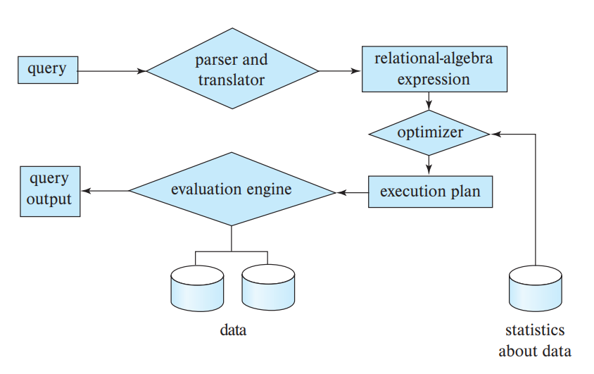
Query processing
Query processing is a complex process that includes:
Parsing a query written in a high-level language and translating it into expressions that can be used to interact with the low-level storage system.
Various query optimization transformations at different levels.
Query evaluation.
*Database System Concepts

Slide 22
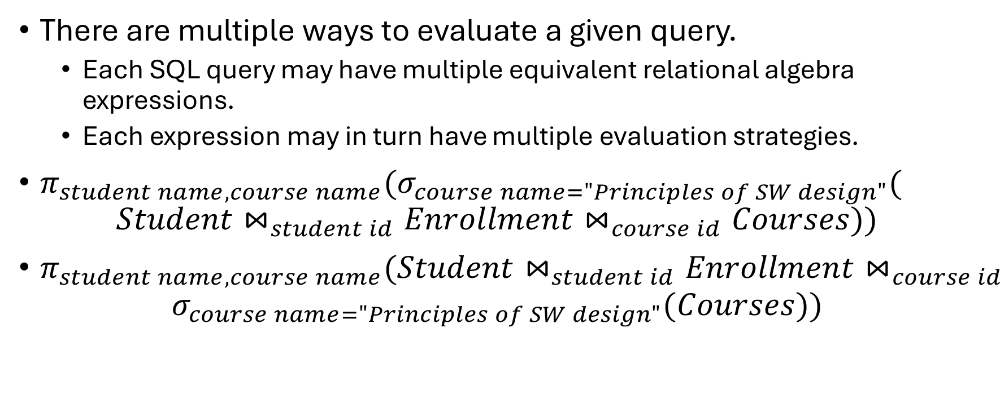
Query processing
SELECT Student.name, Course.name
FROM Student
JOIN Enrollment ON student_id
JOIN Course ON course_id
WHERE Course.name = ‘Principles of SW design';
There are multiple ways to evaluate a given query.
Each SQL query may have multiple equivalent relational algebra expressions.
Each expression may in turn have multiple evaluation strategies.
$π_{student name, course name}(σ_{course name="Principles of SW design"}($
$$Student⋈_{student id}Enrollment⋈_{course id}Courses))$$
$π_{student name, course name}(Student⋈_{student id}Enrollment⋈_{course id}$
$$σ_{course name="Principles of SW design"}(Courses))$$

Slide 23



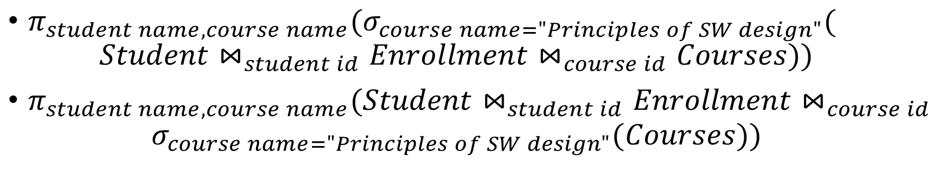





Query processing
SELECT Student.name, Course.name
FROM Student
JOIN Enrollment ON student_id
JOIN Course ON course_id
WHERE Course.name = ‘Principles of SW design';
$π_{student name, course name}(σ_{course name="Principles of SW design"}($
$$Student⋈_{student id}Enrollment⋈_{course id}Courses))$$
$π_{student name, course name}(Student⋈_{student id}Enrollment⋈_{course id}$
$$σ_{course name="Principles of SW design"}(Courses))$$
$$π$$
$$π$$
$$σ$$
$$⋈$$
$$⋈$$
$$σ$$
Courses
$$⋈$$
Courses
$$⋈$$
Enrollment
Students
Enrollment
Students

Slide 24
Query processing
Multiple ways of evaluating a clause in a relational expression exist.
A selection may use a linear scan through all the records in a table applying the predicate sequentially or use an index (likely a B+-tree) to optimize the number of accesses to the storage (Much more optimization parameters exist: data compression & encoding, prefetching, scan data sharing & result caching, multi-threading, and more).
A join can be calculated using a nested loop or by building a hash map from one relation and iterating through the second one while querying the map to check if there is a match.
The optimal choice depends on many factors such as the database schema, data cardinality, current system load (a feedback loop), and the size of required temporary buffers to name a few.

Slide 25
Query processing
SELECT Student.name, Course.name
FROM Student
JOIN Enrollment ON student_id
JOIN Course ON course_id
WHERE Course.name = ‘Principles of SW design';
Specifying how to execute a query plan includes an annotation on how to execute each operator (e.g., indexing, algorithm, etc..).
An evaluation primitive is an annotated relational algebra expression.
A sequence of primitive operations (DAG) is a query execution plan (QEP).
$$π$$
$$π$$
$$σ$$
$$⋈$$
Index 1
Hash join
$$⋈$$
$$σ$$
Nested loop
No index
Courses
$$⋈$$
Courses
$$⋈$$
Enrollment
Students
Enrollment
Students

Slide 26




Query processing
SELECT Student.name, Course.name
FROM Student
JOIN Enrollment ON student_id
JOIN Course ON course_id
WHERE Course.name = ‘Principles of SW design';
A subgraph of a QEP is a pipeline if processing its operators does not require intermediate result materialization.
A pipeline breaker is an operator that requires all its children to emit all the tuples before it finishes (e.g., sub-queries, joins (build), ordering).
$$π$$
$$⋈$$
$$σ$$
Courses
$$⋈$$
Enrollment
Students

Slide 27
Query processing model
A processing model describes how the system processes an execution plan and moves the data between evaluation primitives.
In principle, there are three distinct models:
Materialization model – take a primitive and apply it to all the input tuples to produce a new relation for the next operator to consume.
Iterator (a.k.a. Volcano) model – take a single tuple and process it with a set of operators until result materialization or a pipeline breaker.
Vectorization (or batched) model – a middle ground between the two – process tuples in batches.
The processing model together with the data format significantly affect the performance characteristics of data access. E.g., batched processing of column-store data makes the use of SIMD instructions highly efficient.

Slide 28
Query evaluation optimizations
Query evaluation task exhibits classical optimization traits with similar tradeoffs.
Highly optimized hand-written algorithms.
Specialized to target architecture at a high-level.
Restricted set of implemented operators or their combinations (pipelines).
Precompiled, low overheads (but calls overhead in case of chaining).
Predictable primitive performance characteristics.
Code generation and compiler optimizations.
Use of a generic toolchain, e.g., LLVM.
Arbitrary operator graphs support (if lowering exists).
Extra latency cost for JIT-compilation, grows with the query size (but no calls overhead – inlining).
Complex behavior of the generated code. Hard to predict or verify.
Notes:
Two approaches for compilation: source code generation with operator templates and the use of compiler intermediate representation

Slide 29









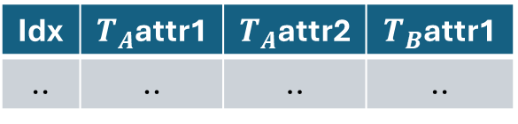







Query optimization
Different query execution plans may have different associated cost as determined by some target metric (e.g., query response latency, processing cost in $, memory consumption, number of disk accesses etc.).
RDBMS takes the responsibility to identify and construct the best possible query execution plan. The process is called query optimization.
Metadata
Logical plan
Physical plan
Evaluation engine
$$σ$$
Optimization
$$π$$
Data
$$⋈$$
$$⋈_{hash}$$
$$π$$
$$π$$
$$σ$$
$$π$$
$$T_{A}$$
$$T_{B}$$
$$T_{A}$$
$$T_{B}$$
Idx | $T_{A}$attr1 | $T_{A}$attr2 | $T_{B}$attr1
.. | .. | .. | ..

Slide 30




Cost modeling
The number of tuples can affect the algorithm choice
The number of valid QEPs grows exponentially. Cost estimation for all possible plan can be impossible within time constraints.
DBMSs use heuristics and algorithms for solving NP-hard problems (e.g., classical approaches such as B&B) to navigate the search space.
Cost modeling is based on the known hardware parameters (e.g., L1$ latency, expected number of disk accesses).
A precise estimate cannot be always achieved due to data dependence – filters cardinality estimation.
DBMS stores additional metadata (such as cardinality), updates it while running queries, and uses it to produce better estimations.
Learning-based methods are explored and used to both estimate data cardinality and navigate the search space.
No way of knowing how many tuples satisfy the predicate
$$π$$
$$⋈$$
$$σ$$
Courses
$$⋈$$
Enrollment
Students

Slide 31
Parallelism & concurrency
Modern architectures are parallel (and heterogeneous).
Performant DBMS implementations need to harness all available resources and provide horizontal and vertical scaling (depending on a use case).
Parallelism occurs at all levels in systems:
Vectorized instructions, aka SIMD (e.g., AVX)
Multi-threading & multi-core systems
Multi-processing (OS)
Distributed (different flavors, slightly different assumptions, e.g., additional requirements for fault tolerance). Note: normally parallel & distributed DB are defined as different things.
*Multiple physical storage devices, etc.
Concurrent access from multiple applications is performed against a single logical view of a database (no dependence on physical view).
Additional stages for query processing (a scheduler to route QEP fragments to appropriate processing nodes.

Slide 32
Parallelism & concurrency
Parallel database architectures:
Share memory – all nodes can directly access the same memory (unified address space)
Shared disk (cluster) – all nodes have a set of common disks. Each node has its own memory and processor.
Shared nothing – no resources are shared.
Hierarchical – a hybrid architecture of the above three.

Slide 33
Parallelism & concurrency
Two approaches to exploiting parallelism:
Intra-query (horizontal) parallelism – parallel implementation of a single query. Multiple instances of an operator are executed concurrently over different sets of data (intra-operator) or concurrent independent (or pipelining) operator/pipeline execution (inter-operator).
Inter-query (vertical) parallelism – multiple queries processed simultaneously. The DBMS resolves concurrent accesses to underlying data structures by providing concurrently-control mechanisms.
Both are used in modern performant engines.
Examples:
Hash-partitioned GROUP BY query.
Hash values calculated for each tuple.
Buffers allocated for each bucket.
Partitioning splits the data into buckets.
Groups evaluated independently.
Multiple users access the same database and request information about their accounts.
Dispatcher routes the queries to appropriate workers.
Each worker computes the result independently. DBMS controls parallelism.
Note: there are other partitioning strategies with pros/cons

Slide 34
The rise of data analytics
Online Transaction Processing (OLTP) – large amount of small concurrently running queries. High temporal & spatial locality.
Day-to-day business activities.
High-demand, strict requirements for latencies.
Traditional systems.
Online Analytical Processing (OLAP) – smaller amount of long-running, usually read-only queries. Accessing large portions of the database.
Data analysis, pattern discovery, forecasting, etc. Anything aiding decision making.
Can be complex, non-standard, exploratory.
Scenarios pose different (often contradictory!) optimization challenges.
Both are required for a modern business to operate.

Slide 35
Extract, Transform, Load (ETL)
ETL is a data integration process to organize data from multiple sources into a single consistent data set (e.g., data lake).
A generic analytical query includes ETL as an essential part. At a high-level, the steps are:
Data search – accessing multiple sources and systems, usually distributed (e.g., HDFS).
Data read – accessing the distributed and sharded physical storage over a network.
Data preprocessing – validation, cleaning, transformation.
Data analysis and report.

Slide 36
BACKUP

